Slide 1
Database System Catalogue
Advanced DBMS (IGNOU MCS 043 )
Block 1 – Unit 4

Slide 2
Agenda
System Catalogue
Types of views
Catalogue in other databases

Slide 3
System Catalogue
It is a collection of tables and views that contain important information about a database.
It is the place where a relational database management system stores schema metadata, such as information about tables and columns, and internal bookkeeping information
Also known as metadata or data dictionary

Slide 4
Data Dictionary
Typically stores
  Names, type and size of db objects
  Constraints on data (PK, FK and others)
  Authorized users, passwords and their privileges
  Indexes
  Number of records, attribute types
  Relation among tables
  Other statistical information

Slide 5
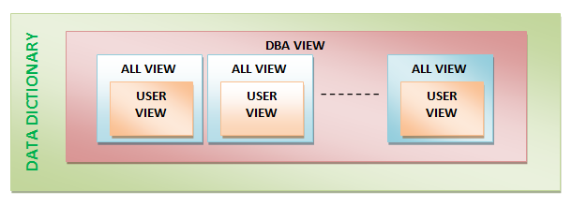
Types of Views

Slide 6
SYS User
Owner of data dictionary
No direct DML operations must be done on SYS tables as it can badly hamper the working of the rdbms

Slide 7
Catalogue in Distributed DB
Catalogue stores locations, fragments and replication information
Approaches
  Centralised
  Fully Replicated
  Partitioned
  Centralised/partitioned

Slide 8
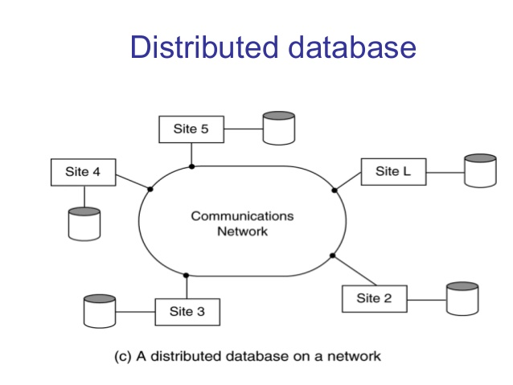

Slide 9
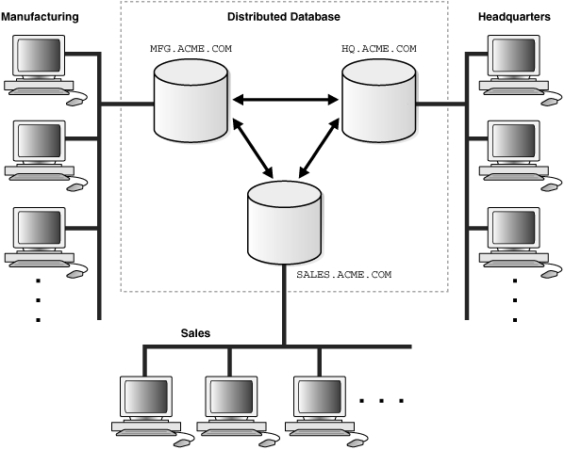

Slide 10
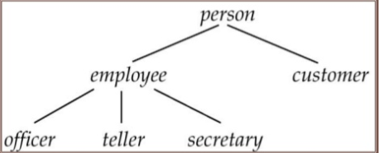
Object Oriented DB
Makes use of classes, inheritance hierarchy and complex relationships

Slide 11
Thank You

